Slide 1
Sahaja AgriculturAL Project
Experimental Results

Slide 2
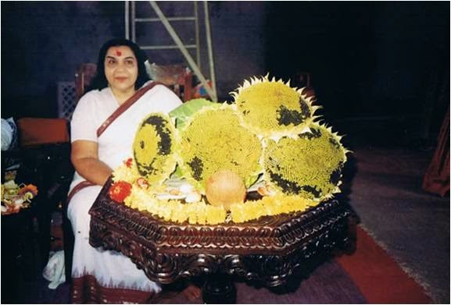
Origins
Shri Mataji, the founder of Sahaja Yoga, experimented with sunflowers in her farmhouse in Puna in the late 1980’s and produced tremendously big ones, more than 12” (30 cm) in diameter and very heavy, giving on average 250 ml of oil

Slide 3
First exeriments using vibrated water
In 1986 Dr. Hamid Mylany conducted experiments in Austria for measuring the effects of Vibrated Water on sunflower and maize
The results showed not only an increase in the growth of the plants but also in the sprouting potential of the seeds
The increase in the sprouting ratio for sunflower passed from the normal 75-80 % to 95-100 %
The harvest increase was measured to be between 20 – 25 %
Dr. Hamid also measured the characteristics of the water and noticed that the connecting angle of the water molecule changed from 104.5° in normal water to 108.45° in vibrated water increasing its capacity to dissolve substances such as NH4 and other nitrogen containing elements
Dr. Hamid did further experiments in 1988 in Vienna to test the effect of vibrated water on animals and found a 15% weight gain compared to two other control groups

Slide 4
Early experiments on crop yields in Rajasthan, India
Field experiments were conducted between 2002 -2004 on Groundnut and Wheat on plots of land using Sahaja agricultural techniques compared to those not using them
 | GROUNDNUT | WHEAT
Experimental body | Maharana Pratap, University of Agriculture & Technology, Udaipur | Prof. G. D. Pareek, Director of Agricultural department, Jaipur
Yield increase | 73 % | 25 – 30 %

Slide 5
Sahaja Agricultural Project
First large scale experiment using Sahaja Yoga techniques on agriculture, set up by a Sahaja agricultural committee formed in Maharashtra in 2010
Field experiment done on Kharif crops which are domesticated plants cultivated and harvested during the rainy or monsoon season
Started in June 2011 throughout the state of Maharashtra, India
Systematic data was collected from 66 farmers who reported their observations from time to time
Comparison was made of 2 lots/groups, namely vibrated (E) and non- vibrated (C); data was compiled , tabulated and compared for the following observations:
  Germination of seeds
  Plant growth
  Crop product characteristics
  Yield of crops

Slide 6
Sahaja Agricultural Project - Results
Increase in germination of seeds from 0 – 20 %
Germination of seeds as influenced by Vibrations (percent)
Crop | n | Experimental E (Vibrated) | Control C (Non Vibrated) | % increase over Control
Soyabean | 70 | 92.4 | 82 | 12.2
Cotton | 60 | 86.5 | 72.0 | 20.0
Maize | 70 | 70 | 60 | 16.6
Hy. Sorghum | 20 | 60 | 50 | 20
Bajara | 10 | 90 | 90
Onion | 10 | 80 | 80

Slide 7
Sahaja Agricultural Project - Results
Increase in plant growth from 0 – 42.9 %
Plant growth as influenced by Vibrations
Crop | n | Parameter | Experimental E (Vibrated) | Control C (Non Vibrated) | % increase over Control
Soya bean | 70 | Height (cm) | 57.5 | 43.2 | 33.3
Sugar Cane | 20 | No of nodes after 6 mths (Ratoon) | 23.5 | 17.5 | 34.2
 |  | Av. Node girth (cm) | 5 | 3.5 | 42.9
Cotton | 60 | Height (cm) | 32.8 | 27.9 | 18
Maize | 70 | Height (cm) | 180 | 150 | 20
Bajara | 10 | Height (cm) | 84 | 78 | 7.7
Onion | 10 | Height | 7.5 | 7.5

Slide 8
Sahaja Agricultural Project - Results
Increase in different plant characteristics from 6 – 80 %
Crop product characters as influenced by Vibrations
Crop | n | Product Character | Experimental E (Vibrated) | Control C (Non Vibrated) | % increase over Control
Cotton | 60 | Boll weight (gm) | 5 | 3.5 | 42.9
Bajara | 10 | Earhead size | 10.75 | 10.1 | 6.49
 |  | 100 grain weight (gm) | 2.45 | 1.76 | 39.2
Maize | 70 | Cob size (cm) | 16.57 | 15.42 | 7.6
 |  | 100 grain weight (gm) | 43.7 | 31 | 53.8
Chavali | 10 | Pod size (cm) | 20 | 16 | 25
 |  | 100 grain weight (gm) | 18 | 10 | 80

Slide 9
Sahaja Agricultural Project - Results
Increase in yields from 14 – 50 %
Yield of crops as influenced by Vibrations
Crop | n | Yield / acre Experimental E (Vibrated) | Yield / acre Control C (Non Vibrated) | % increase over Control
Soya bean | 70 | 9.71 | 7.82 | 24.2
(Quintal)
Cotton (Q) | 60 | 11.1 | 8.0 | 37.8
(in 2 pickings)
Maize (Q) | 70 | 26 | 20 | 30
Hy. Sorghum (Q) | 20 | 15 | 10 | 50
Bajara (Q) | 10 | 16 | 14 | 14.3
Onion | 10 | 15 | 11 | 36

Slide 10
Sahaja Agricultural Project – recent developments
Following the encouraging results of the 2011 field experiments in Maharashtra, a 2nd phase of experiments was launched on a national level in 10 states of India
Under the project 15000 farmers have been introduced to Sahaja Yoga and Sahaja agriculture
4.5 – 5.0 quintals of high yielding vibrated seeds have been given away to farmers
Farmers from different states have reported improvements by practicing Sahaja agricultural techniques:
  Higher production
  Better germination & growth of plants/crops
  Protection against natural calamities & insects/pests
  Improved quality of cattle feed to improve body weight & production
  Improved health of cattle
  Increased milk production and egg laying, etc.

Slide 11
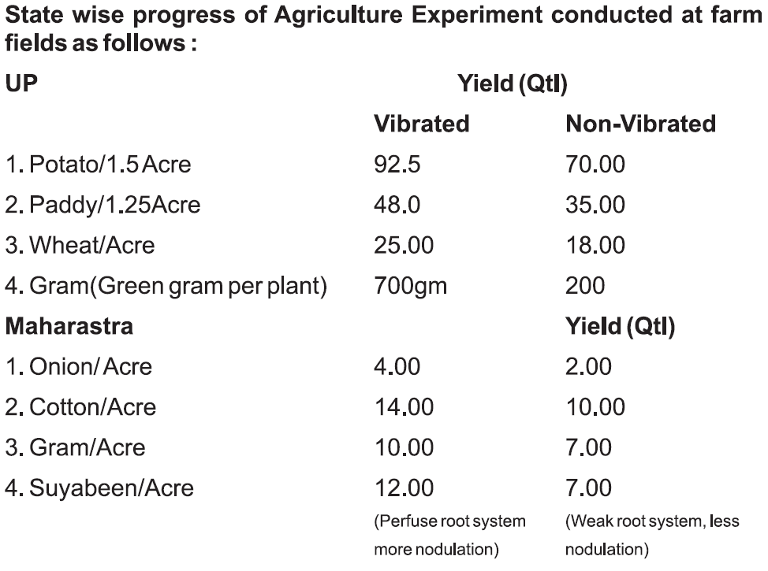
Sahaja Agricultural Project – recent developments

